Slide 1
Regular Expressions a very quick introduction
Part of: R café 11 december 2017
Jonathan de Bruin Data scientist, ITS Utrecht
Tessa Pronk Data- and Informationspecialist, UB Utrecht
RDM Support

Slide 2
Resources for learning about regular expressions:
https://cran.r-project.org/web/packages/stringr/vignettes/regular-expressions.html
http://r4ds.had.co.nz/strings.html#matching-patterns-with-regular-expressions
https://regexcrossword.com/
This short introduction was modified from a Python regular expression workhop given by Harrison Dekker (University of California Berkely) at Iassist 2016.

Slide 3
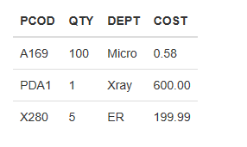
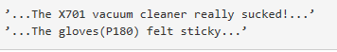
What are regular expressions?
Regular expressions are specific sequences of characters that broadly or narrowly match patterns
Why regular expressions?
How would you extract the product codes for ‘company X’ products (a capital followed by three numbers) in these examples?
“[A-Z]\\d{3}”
Example 1
Example 2

Slide 4
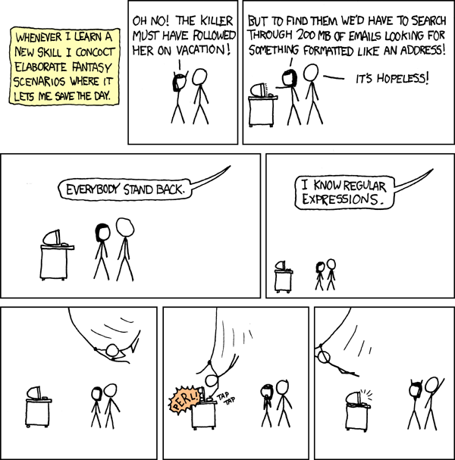
https://xkcd.com/208/

Slide 5
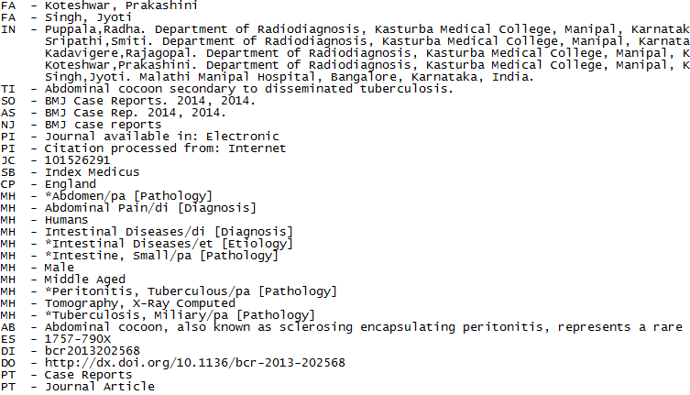
My case study: extract Title and Abstract from many, many, Medline records.

Slide 6
What you need to know to write regular expressions:
How to define sets of characters
Metacharacters: i.e. all digits, all characters, all tabs
Character sets: i.e. only these digits, only these characters
How many times to repeat them
A specific number of times
An unlimited number of times
How to define their position
End of line
Beginning of line
Word boundary

Slide 7
Sets of characters
Metacharacters
Metacharacters are pre-defined sets of characters.
. matches ANY character except the newline character \n
\d matches digits 0 through 9
\w matches alphanumeric characters and underscore
\s matches any whitespace
\t Tabs
\n Newline
ETC.
TYPE ALONG in R:
Txt <- "SA_1234"
regmatches ( Txt , regexpr ("\\w", Txt )) regmatches ( Txt , gregexpr ("\\w", Txt ))
regmatches ( Txt , gregexpr ("\\d" , Txt ))
R treats backslashes as escape values for character constants. (... and so do regular expressions. Hence the need for two backslashes when supplying a character argument for a pattern. The first one isn't actually a character, but rather it makes the second one into a character.)

Slide 8
Sets of characters
Character sets
[AGCT] matches one character A, G, C or T.
[\s\d] matches one whitespace character or digit
Define a range of characters
[A-T] matches one character between A and T.
[1-7] matches one digit between 1 and 7.
Ranges as defined by ASCII or Unicode tables
You can combine ranges: [a-cA-C]
TYPE ALONG in R:
regmatches(d , gregexpr("[A-Z]", Txt))
Notes:
In your datapackage (more tips when during your research!!)

Slide 9
How to define where they are
Position of the pattern
We can say a regex has to be at the start or the end of the string, or at word boundaries, with more special characters.
^ beginning of line
$ endofline
\b word boundary
Examples:
^Hallo$
\bHallo\b
TYPE ALONG in R:
regmatches(d , gregexpr("^[A-Z]", Txt))

Slide 10
Repetitions
How to define repetitions
Three digits: \d\d\d. How about matching thirty or a thousand digits?
Fortunately, regular expressions let us express this very succinctly.
\* means 0 or more times
\+ means 1 or more times
? means 0 or 1 times
{n} means n times exactly
{m,} means m or more times
{m,n} means m–n times
Example: .* matches anything
Example: [a-c]{3} matches ’abc’ etc
TYPE ALONG in R:
regmatches(d , gregexpr("[A-Z]{2}", Txt))
regmatches(d , gregexpr("[0-9]{3}", Txt))

Slide 11
Specifying alternatives
Sometimes you want to say match this OR that. You can do that with the | operator.
Alex|Bill|Conrad matches any of these three names.
Sometimes there can be confusion about what | refers to. In such cases, put brackets around the alternatives.
Jim and (Alex|Bill|Conrad) matches ’Jim and Alex’, ’Jim and Bill’, etc

Slide 12
Defining complements of a set
Sometimes it’s easier to define a set of characters as “everything other than X”.
\S – all non-whitespace characters
\W – all non-alphanumeric characters (also excludes underscore)
\D – all non-numeric characters
[^A-D] – all characters other than A, B, C, D

Slide 13
Doing stuff with regular expressions
For instance:
Capture the matches and do stuff with them
Replace the match with something else
Split a string whenever you match the regex

Slide 14
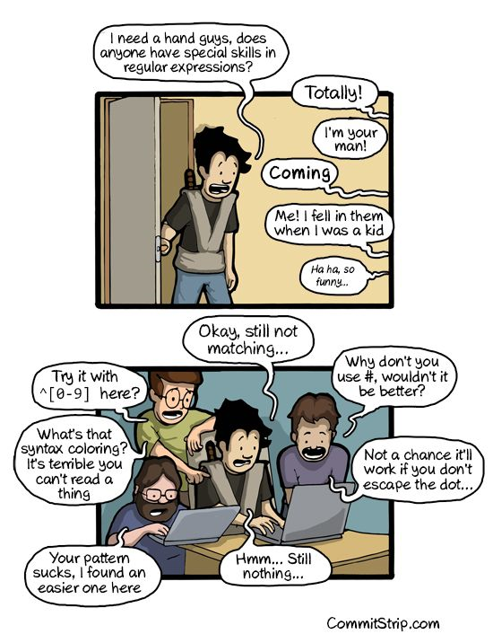
https://i.pinimg.com/736x/69/12/75/691275562b5f25b68c4c56fb2bce92d9--regular-expression-programming.jpg

